Slide 1
LAB Ⅱ LECTURE 05
Modern C++
Seoul National University
Graphics & Media Lab
Notes:
저도 조교하면서 실습을 먼저 강의하는 것은 처음. 슬퍼하지 마시고 너무..

Slide 2
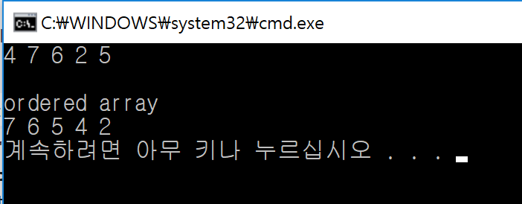
Mission
Implement a program
Input
Arbitrary number of integers (using while(cin >> num) != EOF)
When “CTRL+d” is entered, finish input loop
Print out the numbers in descending order
Condition
Using STL::vector
Using auto keyword
Using range-based for loop

Slide 3
Contents
What is modern C++?
New features in modern C++ which are covered in this class:
nullptr
Automatic Type Deduction
Range based for loop

Slide 4


History of C++
Developed by Bjarne Stroustrup in 1985
Extension of the C language
Standardized by ISO in 1998 (C++98)

Slide 5
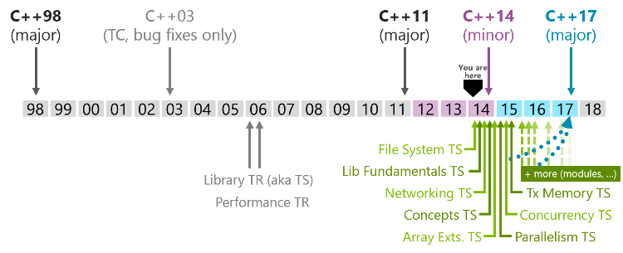
C++ Standard
Modern C++

Slide 6
New Feature in Modern C++
Lambda expression
Automatic type deduction and ‘decltype’
Uniform initialization syntax
Deleted and defaulted functions
nullptr
Range-based for loop
Strongly-typed enums
Smart pointers
…

Slide 7
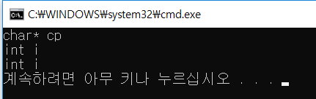
nullptr
Use 0 or NULL when pointer is empty
In C++, type of NULL is ‘int’
When use NULL as parameter of function
Function call of ‘int’ type of parameter
#include <iostream>
void main(){
char *cp = NULL;
char *cp1 = 0;
}
#include <iostream>
using namespace std;
void f(char* cp){
cout << "char* cp" << endl;
}
void f(int i){
cout << "int i" << endl;
}
void main(){
char *cp = NULL;
f(cp);
f(NULL);
f(0);
}

Slide 8
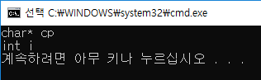
nullptr
Use nullptr instead of NULL or 0
#include <iostream>
using namespace std;
void f(char* cp){
cout << "char* cp" << endl;
}
void f(int i){
cout << "int i" << endl;
}
void main(){
int *ip = nullptr;
f(nullptr);
f(0);
}

Slide 9
Automatic Type Deduction
In C++, you must specify the type of an object when you declare it.
Static programming language
Java, C#...
In dynamic programming language
Type of variable is automatically deduced as the program is compiled.
Python, JavaScript …
void main(){
int a = 1;
char c = 'a';
double d = 0.1;
}
C++
x = 34 - 23
y = "Hello"
z = 3.45
Python
x = 34 - 23
print(x)
x = "Hello"
print(x)
Python

Slide 10
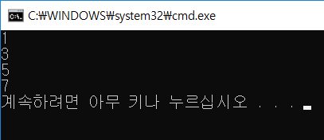
Modern C++ Allows Automatic Type Deduction
When you use template or more advanced feature, defining type of return variable is difficult
Use keyword ‘auto’
#include <iostream>
#include <vector>
void main(){
std::vector<int> vec;
vec.push_back(1);
vec.push_back(3);
vec.push_back(5);
vec.push_back(7);
for(std::vector<int>::iterator it = vec.begin(); it<vec.end(); it++){
std::cout << *it << std::endl;
}
}
for(auto it = vec.begin(); it<vec.end(); it++){
std::cout << *it << std::endl;
}

Slide 11
Modern C++ Allows Automatic Type Deduction
void main(){
auto d = 5.0;
auto i = 1+2;
}
Keyword ‘auto’
Compiler infers the type of the variable
Assignment
Return type from function
Can not use
Declare without initialization
Parameter of function
int add(int x, int y){
return x+y;
}
void main(){
auto sum = add(5,6);
}
auto d = 5.0; // OK
auto a; // ERROR
int f(auto i, int x){
return x+i;
}

Slide 12
Modern C++ Allows Automatic Type Deduction
Keyword ‘decltype’
decltype(entity)
Inspects the declared type of an entity
#include <iostream>
using namespace std;
void main(){
auto a = 2;
decltype(a) b = 3;
decltype(a+b) c = a+b;
auto d = sqrt(a*a+b*b);
cout << d << endl;
}
int
int

Slide 13
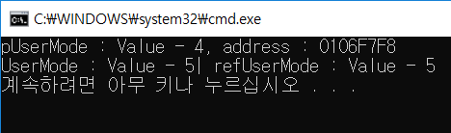
Practice
#include <iostream>
using namespace std;
void main(){
int UserMode = 4;
auto* pUserMode = &UserMode;
cout << "pUserMode : Value - " << *pUserMode
<< ", address : " << pUserMode << std::endl;
decltype(UserMode)& refUserMode = UserMode;
refUserMode = 5;
cout << "UserMode : Value - " << UserMode
<< "| refUserMode : Value - " << refUserMode << endl;
}

Slide 14
Range Based For Loop
C++ for loop
for( initialization, condition, increment or decrement)
Range based for Loop
for(declaration, expression)
#include <iostream>
using namespace std;
void main(){
int numList[5] = {1,2,3,4,5};
for(int i=0; i<5; i++){
cout << numList[i] << endl;
}
}
void main(){
int numList[5] = {1,2,3,4,5};
for(int i : numList){
cout << i << endl;
}
}
void main(){
int numList[5] = {1,2,3,4,5};
for(auto i : numList){
cout << i << endl;
}
}

Slide 15
Range Based For Loop
void main(){
int numList[5] = {1,2,3,4,5};
for(auto i : numList){
cout << i << endl;
}
}
Executes a for loop over a range
Limitation
Can not customize
Print only first 3 elements in array of size 5
Forward loop

Slide 16
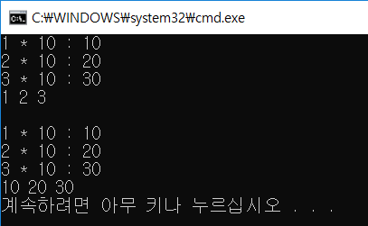
Practice
#include <iostream>
#include <vector>
using namespace std;
void main(){
vector<int> NumberList;
NumberList.push_back(1);
NumberList.push_back(2);
NumberList.push_back(3);
for(auto i : NumberList){
cout << i << " * 10 : ";
i *= 10;
cout << i << endl;
}
for(auto i : NumberList)
cout << i << " ";
cout << endl << endl;
for(auto &i : NumberList){
cout << i << " * 10 : ";
i *= 10;
cout << i << endl;
}
for(auto i : NumberList)
cout << i << " ";
cout << endl;
}

Slide 17
Mission
Implement a program
Input
Arbitrary number of integers (using while(cin >> num))
When “CTRL+d” is entered, finish input loop
Print out the numbers in descending order
Condition
Using STL::vector
Using auto keyword
Using range-based for loop

Slide 18
Mission
Save source code file as your student number
2014-12345.cpp
Fork our repo, https://github.com/handdgi/lab02_05.git
Commit and push to your forked repo
Create pull request with message “student number”

